Slide 1
Reddit
By Darius

Slide 2

WHAT IS REDDIT?
* Social news website * content ratter * discussion website * used for endless conversations * Reddit was founded in 2005 by Steve Huffman and Alexis Ohanian.

Slide 3
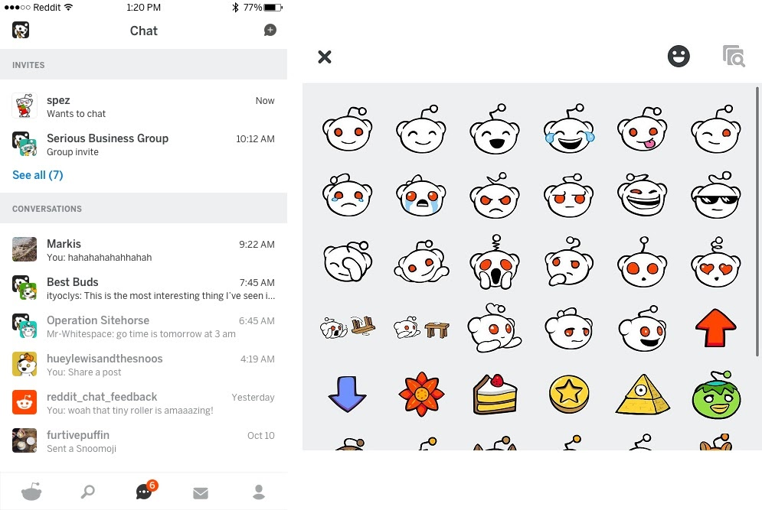
KEY FEATURES OF REDDIT
*CREATE COMMUNTIES *SHARE WITH FAMILY AND FRIENDS *CREATE/ STYLE AVATARS *ADVERSTISE YOUR OWN BUSINESS *PREMIUM MEMBERSHIPS

Slide 4
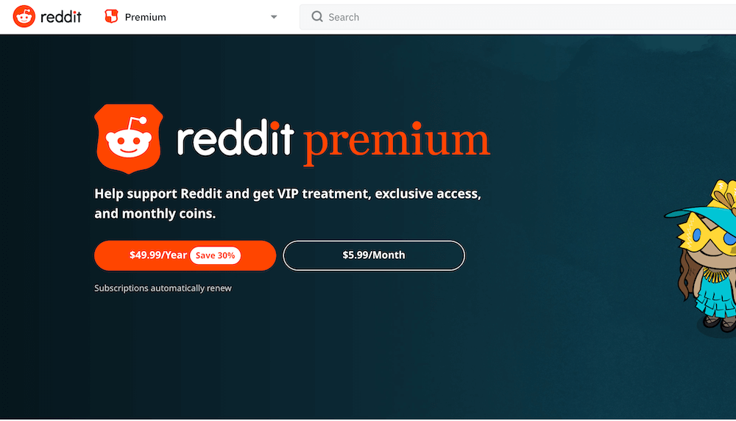
REDDIT PLANS

Slide 5

WHY USE REDDIT?
* REDDIT PREMUIM *SHARE PHOTOS OR VIDEOS *LEARN ABOUT NEWS OR OTHER EVENTS *CREATE/OR STYLE AVATARS *CREATE ADS TO ADVERSTISE BUSINESS

Slide 6
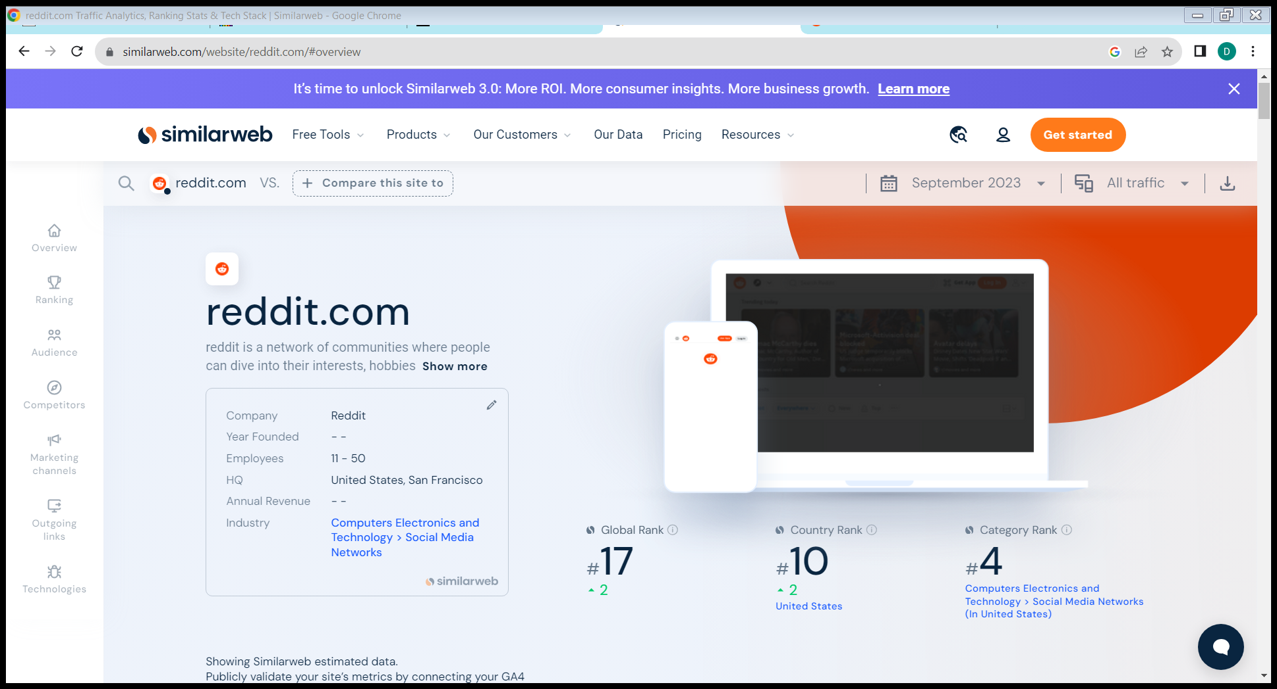
WHERE DOES REDDIT RANK WORLD WIDE?
*TOTAL VISITS PER MONTH:1.6 BILLION It is the 12th most visited website in the United States.

Slide 7
What is reddit? A. discussion website B. a sports page blog c. a podcast website D. a comedy show

Slide 8
When was reddit founded? A. 2005 B.2010 c. 2007 D.2008

Slide 9
Where does reddit rank in the usa? A. 30th B. 2th C. 10th D.6th

Slide 10
How many plan options does reddit have? A. 0 B. 3 C. 2 D.5

Slide 11
How much does reddit premium cost? A. 5.99 B.3.99 C.8.99 D. 10.00

