Slide 1
Reddit

Slide 2

WHAT IS REDDIT?
* Social news website * content ratter * discussion website * used for endless conversations * Reddit was founded in 2005 by Steve Huffman and Alexis Ohanian.

Slide 3
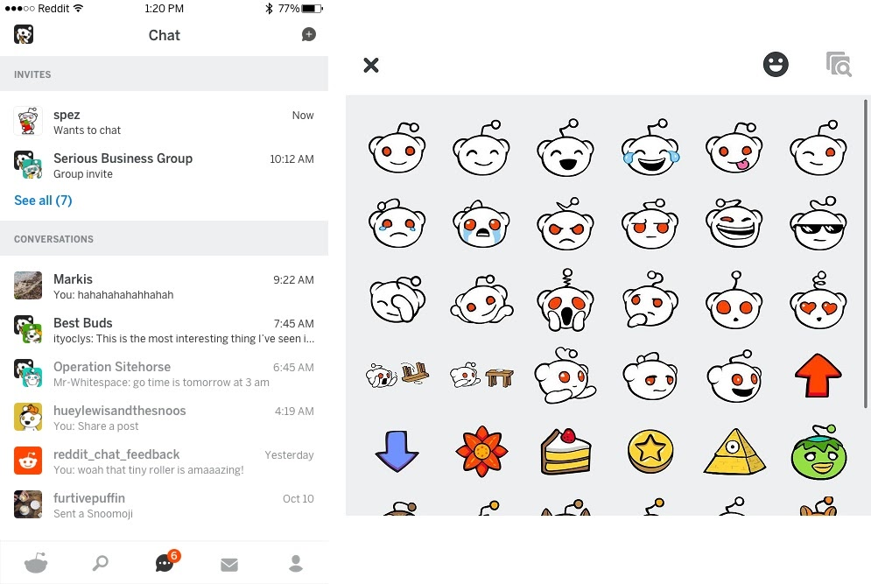
KEY FEATURES OF REDDIT
*CREATE COMMUNTIES *SHARE WITH FAMILY AND FRIENDS *CREATE/ STYLE AVATARS *ADVERSTISE YOUR OWN BUSINESS *PREMIUM MEMBERSHIPS

Slide 4
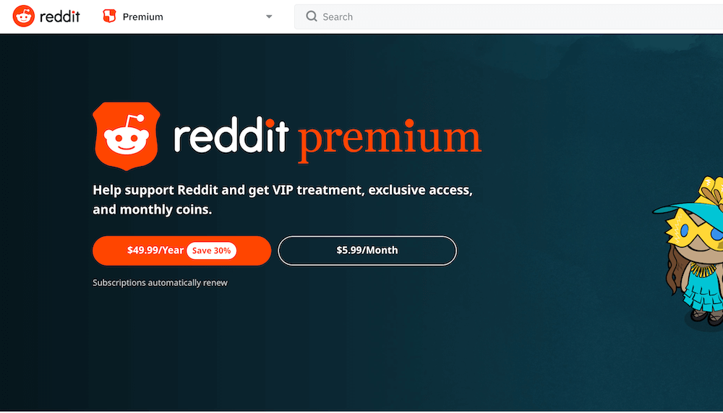
REDDIT PLANS

Slide 5

WHY USE REDDIT?
* REDDIT PREMUIM *SHARE PHOTOS OR VIDEOS *LEARN ABOUT NEWS OR OTHER EVENTS *CREATE/OR STYLE AVATARS *CREATE ADS TO ADVERSTISE BUSINESS

Slide 6
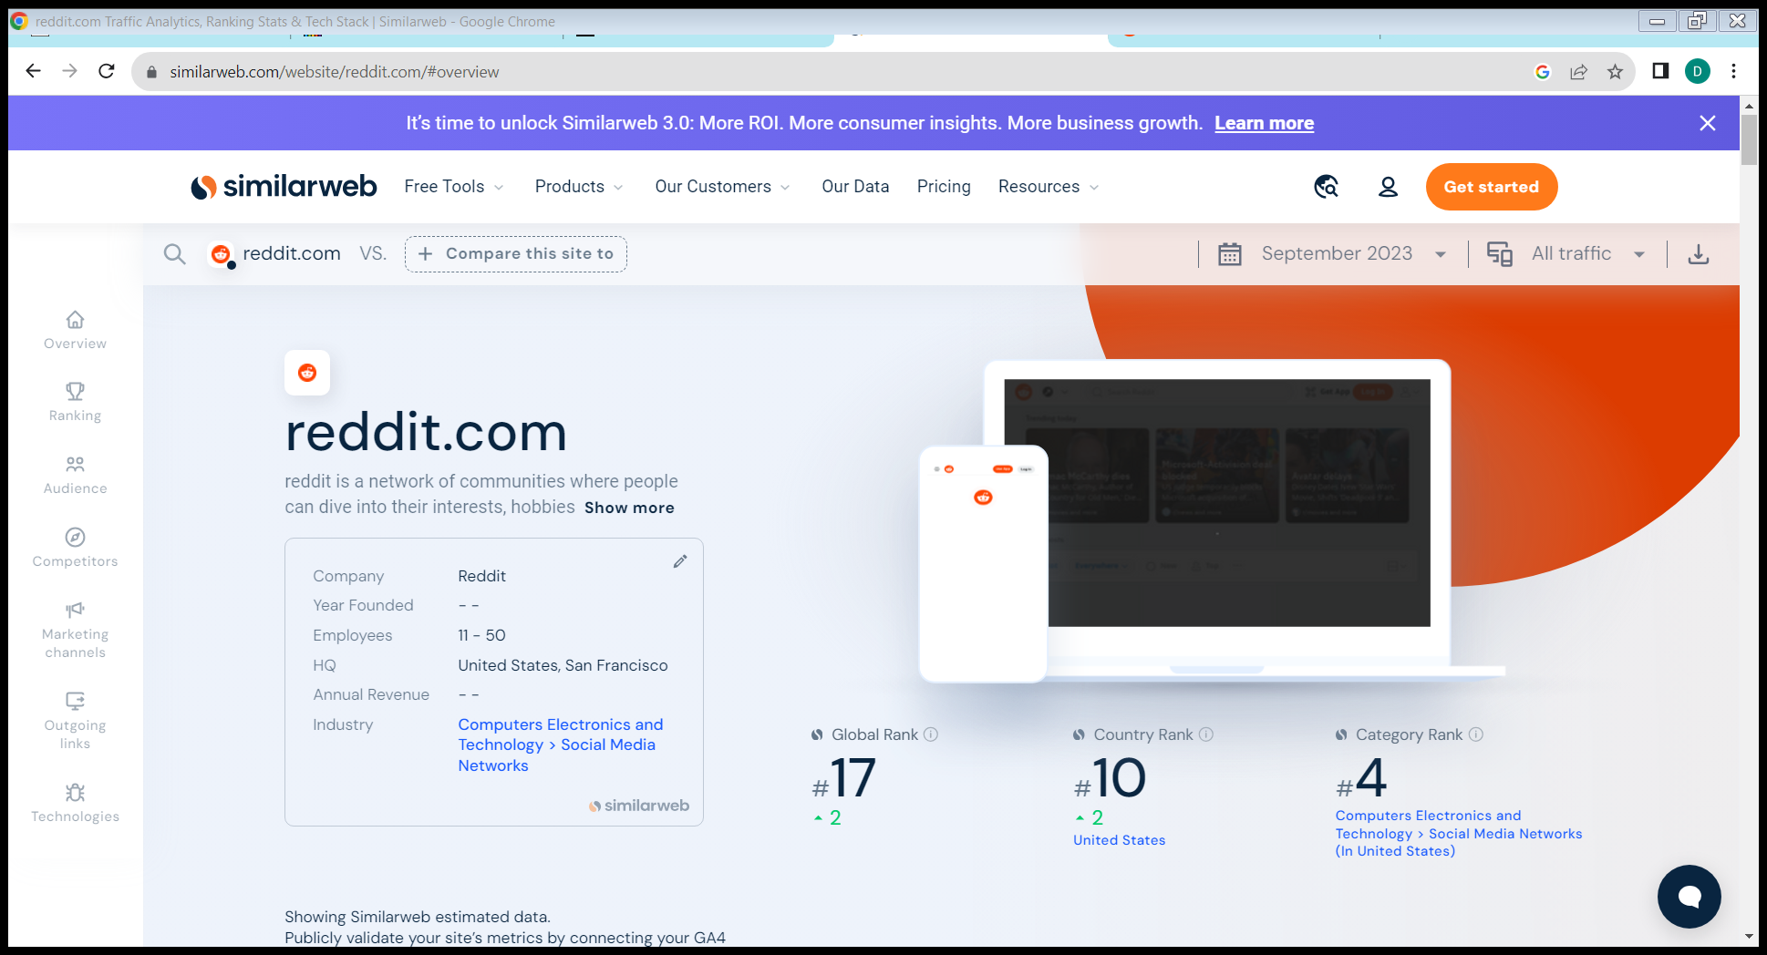
WHERE DOES REDDIT RANK WORLD WIDE?
*TOTAL VISITS PER MONTH:1.6 BILLION It is the 12th most visited website in the United States.

